Slide 1

Functional JavaScript
iterative functions, array manipulations, function composition

Slide 2
Functional JavaScript
JavaScript is a multi-paradigm language
It can be used to program functionally
FP idioms:
iterative functions, which can replace loops,
list processing
function manipulations
immutability
pure functions
branching
... and many other things,
Can help us to keep code:
smaller
cleaner/readable/semantic
testable
reusable
maintainable
….
more fun

Slide 3
RECAP: 02.02-functions.pptx

Slide 4
Array iteration and processing functions
more readable array (list) iterations and transformations

Slide 5
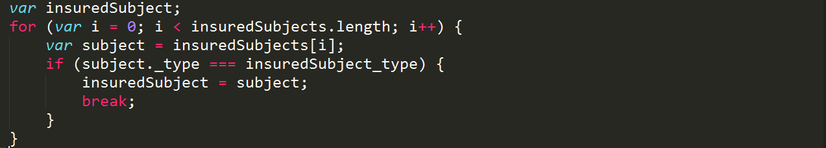
JavaScript – "ugly" "for"
for, while, do while
they exist from Basic … Java
Bad:
Verbose
Not semantic
Not reusable
Good:
…
keď sa pozriem na FOR cyklus neviem čo robí, lebo
robiť hocičo
veľa vecí naraz
cyclomatic complexity
for, if,. for, while all nested

Slide 6
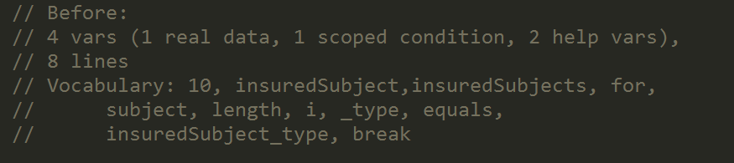
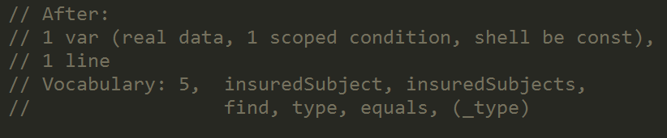
JavaScript - "ugly" "for"
How it is done
What it does

Slide 7
JavaScript - array extras vs ugly “for”
mapping variants of for, to semantic methods
Function | In | Out | loop eq. | ES
map | [], N | [], N | var [], for, push, return []
filter | [], N | [], M<N | var [], for, if, push, return []
reduce | [] | {}, [], whatever,… | var [], for, if, push, return {}
reduceRight | [] | {}, [], whatever,… | var [], for (i--), if, push, return {}
some | [] | boolean | var b, for, if return true
every | [] | boolean | var b, for, if return false
forEach | [] |  | for
find | [] of items | item | for, if return a[i]; return;
fill | [], item | [] of items | var [], for, push, return []
from | [], iterable | [] | var [], for, push, return []
Notes:
For loop is not semantic, looking at code you cannot tell (quickly) what is the code intention,
Different semantics have same code

Slide 8
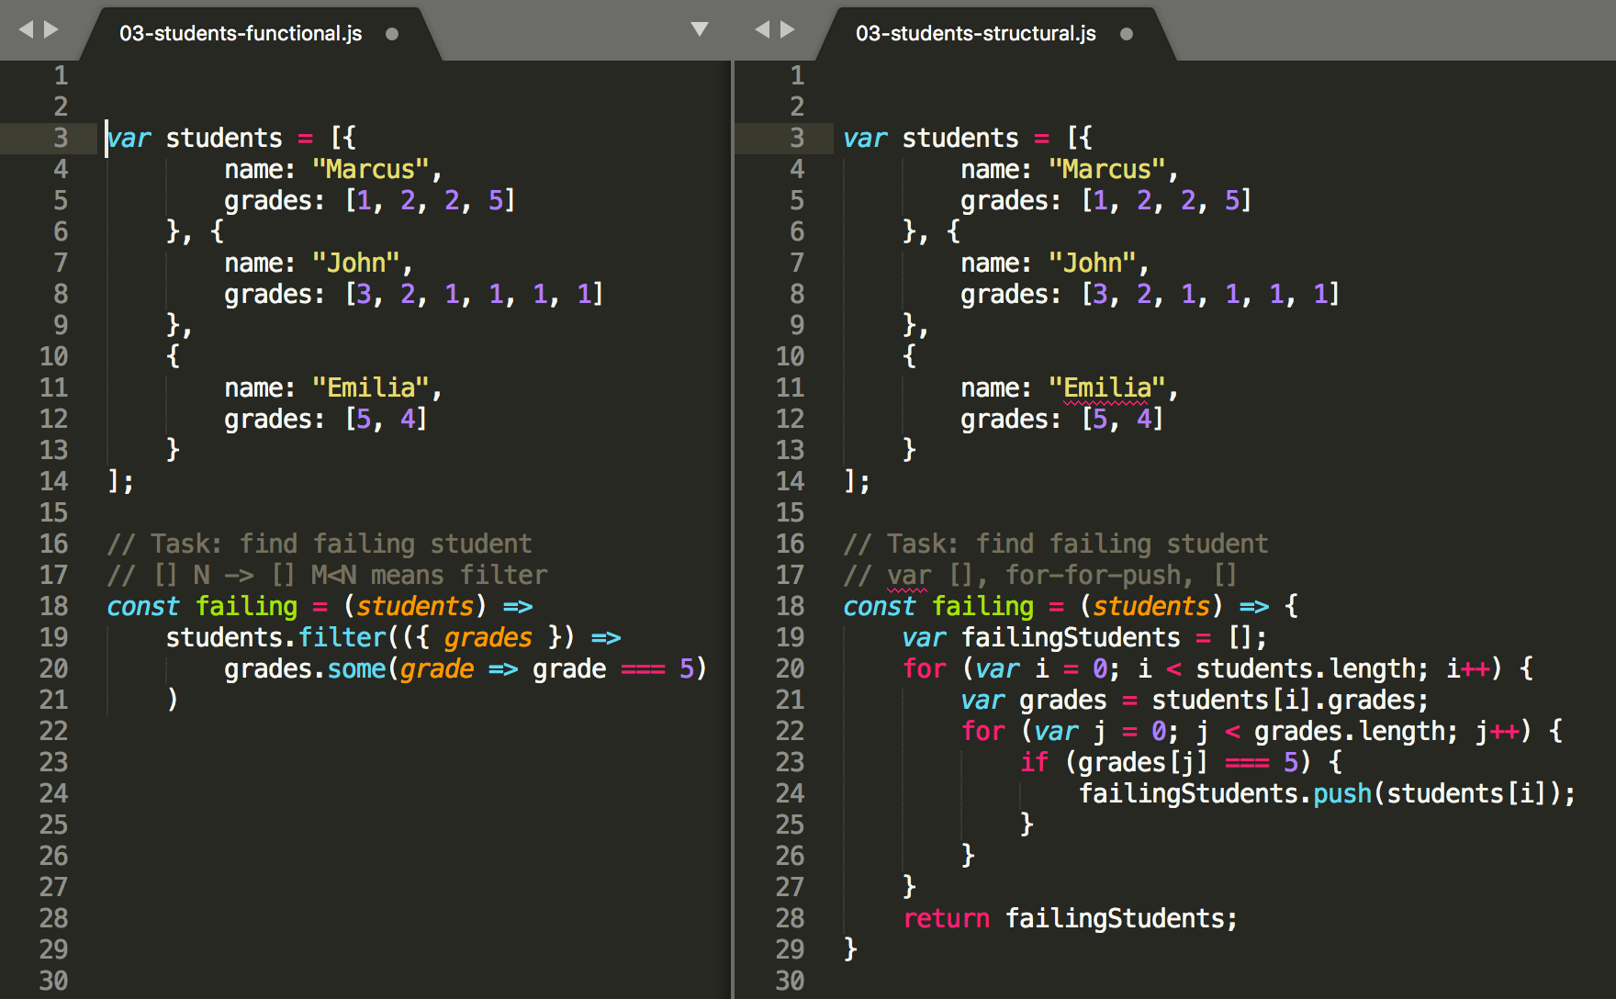
filter vs. for

Slide 9
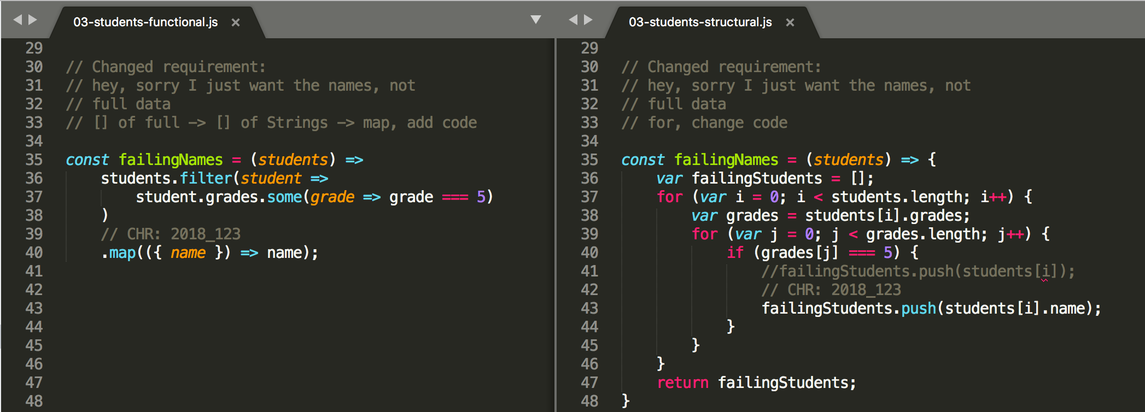
JavaScript - Array Extras vs ugly “for”
implementing changes in functional vs. structured
it can be addition
it is mostly change

Slide 10
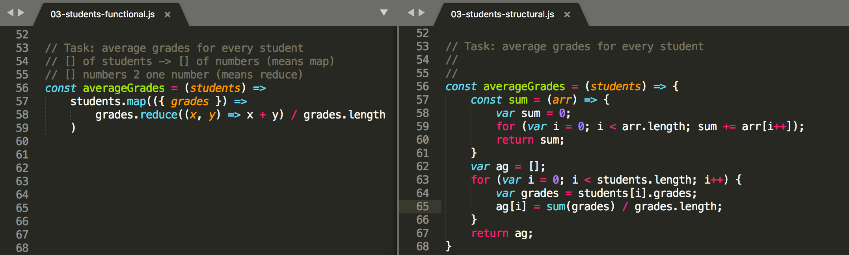
reduce vs. for

Slide 11
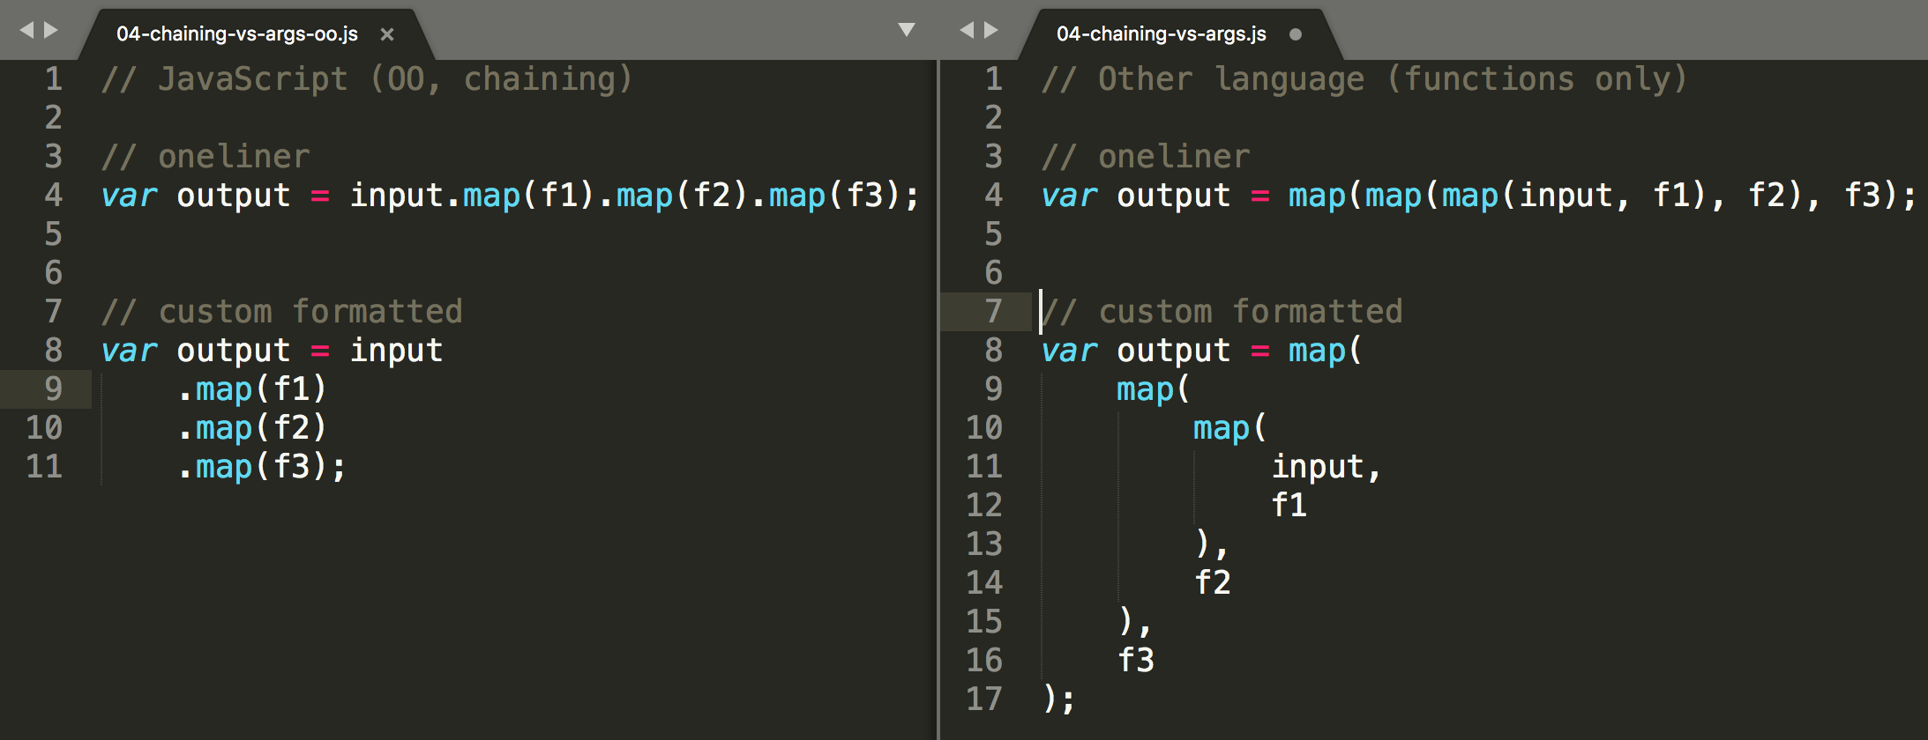
JavaScript - best of both worlds chaining of array functions

Slide 12
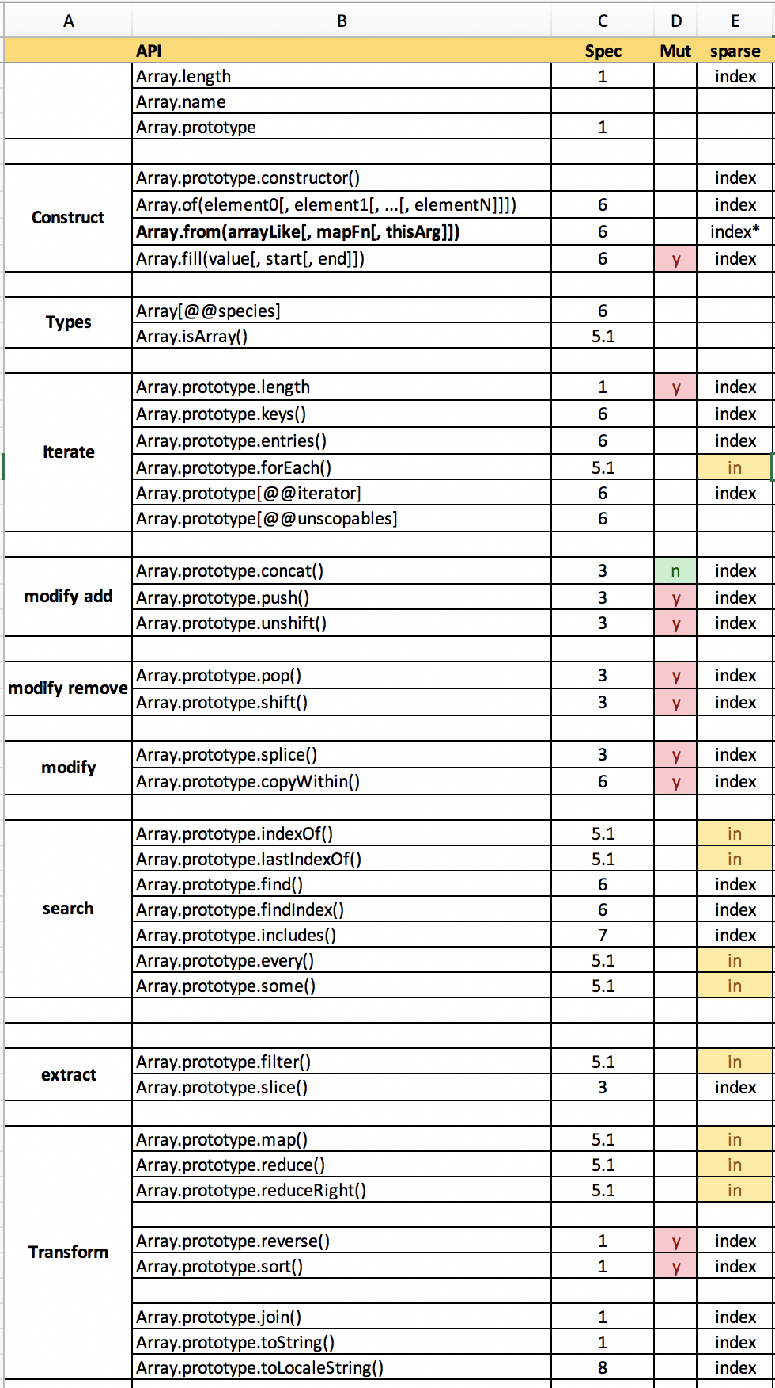
array extras vs. for loop iterating arrays
mame sparse arrays
a su dva sposoby iterovania nad array, podla pouziteho API
over index from 0 to length-1 (vsecky itemy)
ostatne
over defined array keys (iba definovane itemy)
Array.prototype.forEach()
Array.prototype.indexOf()
Array.prototype.lastIndexOf()
Array.prototype.filter()
Array.prototype.map()* – but returns length
Array.prototype.every()
Array.prototype.some()
Array.prototype.reduce()
Array.prototype.reduceRight()

Slide 13
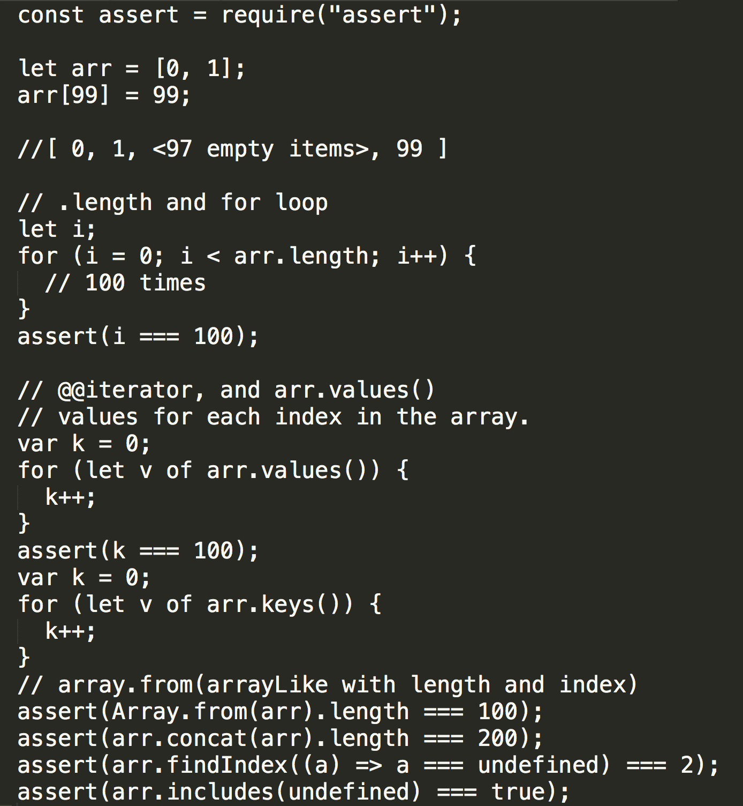

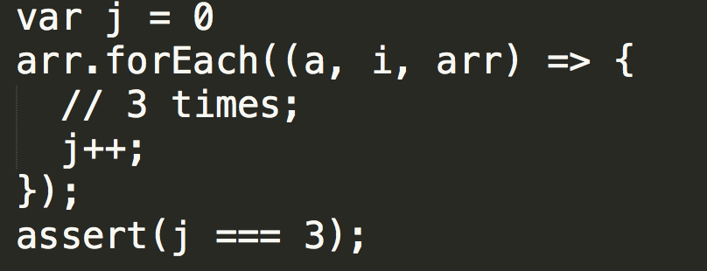
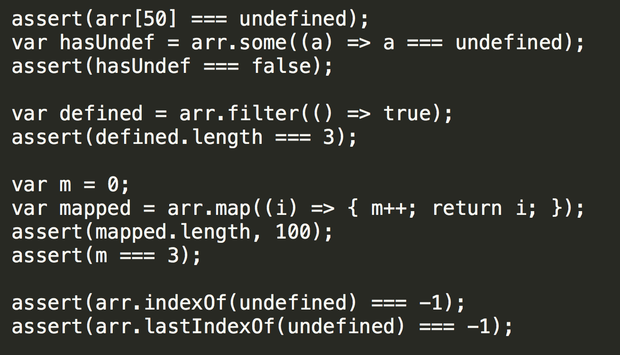
array extras vs. for loop

Slide 14
function composition

Slide 15
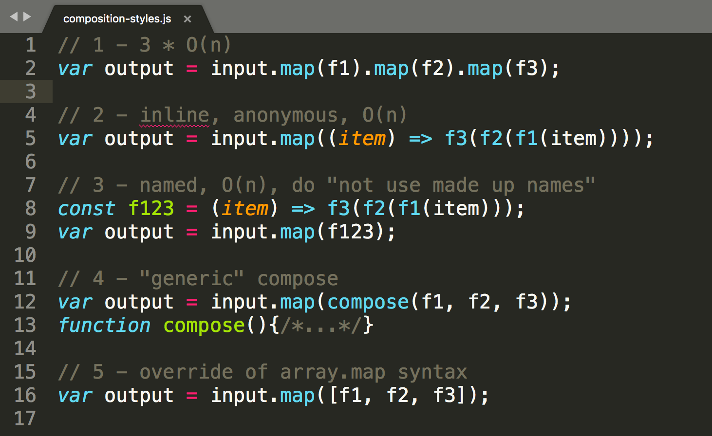
Composition styles inline, adhoc, generic
1. readable
reused,
slow 400ms
2. readable,
reused
fast 120ms
3. readable,
reused
fast 120ms
4. readable,
reused
fast 153ms
slow 300ms
5. readable
reused,
non standard

Slide 16
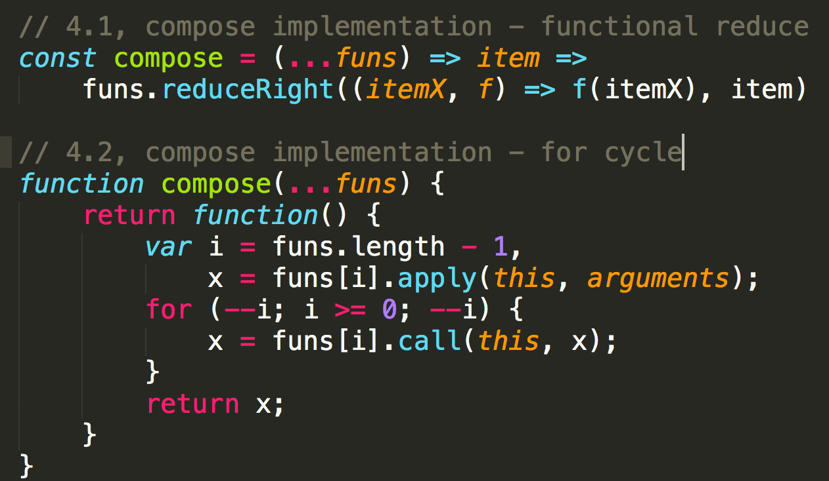
Composition - compose() implementations
JavaScript language
does not have API for
“generic compose” or
“construct”
Observe these 2
sample implementations.
still naive,
not exact semantics as
map.map.map
because of (i, items).
Just as an example
of performance of
good old “for” [1]
300ms
153ms

Slide 17

Functional vs. others
Keep it sane
function is basic JS construct
functions to methods
methods to functions

Slide 18
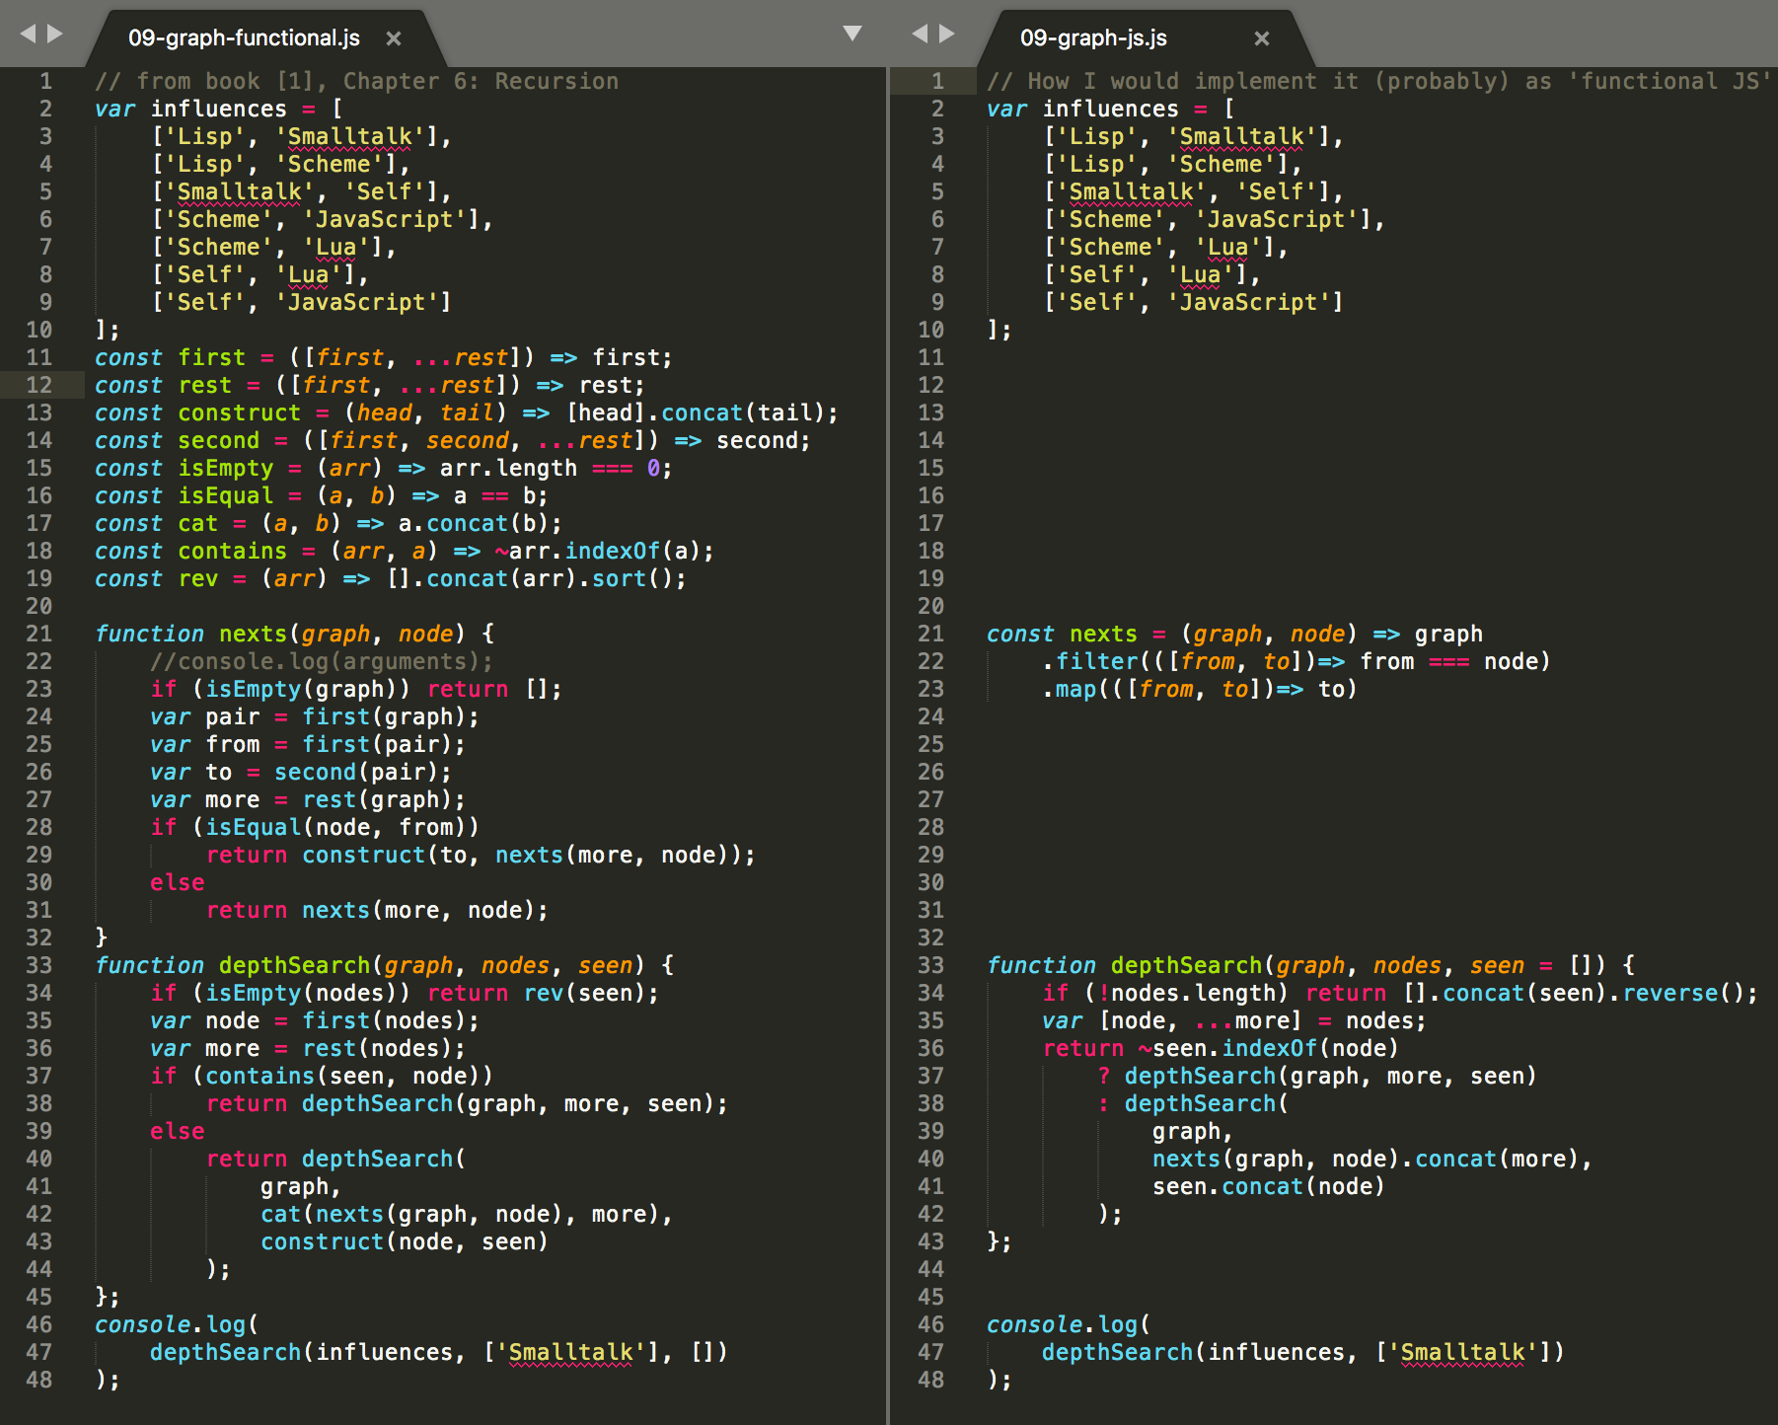
JavaScript - too much functional ?
Alebo čo sa stane, keď to “preženiete”.
is this still JavaScript ?
how many JS people
will have to read it,
and will understand ?
Do you want to study
custom APIs (vocabularies) or use
“idiomatic JS” (for common oneliners) ?
is recursion really “best” for this structure parsing ?
is functional really best for this ? (internal data structure hiding)
which functions are really reusable ?

Slide 19
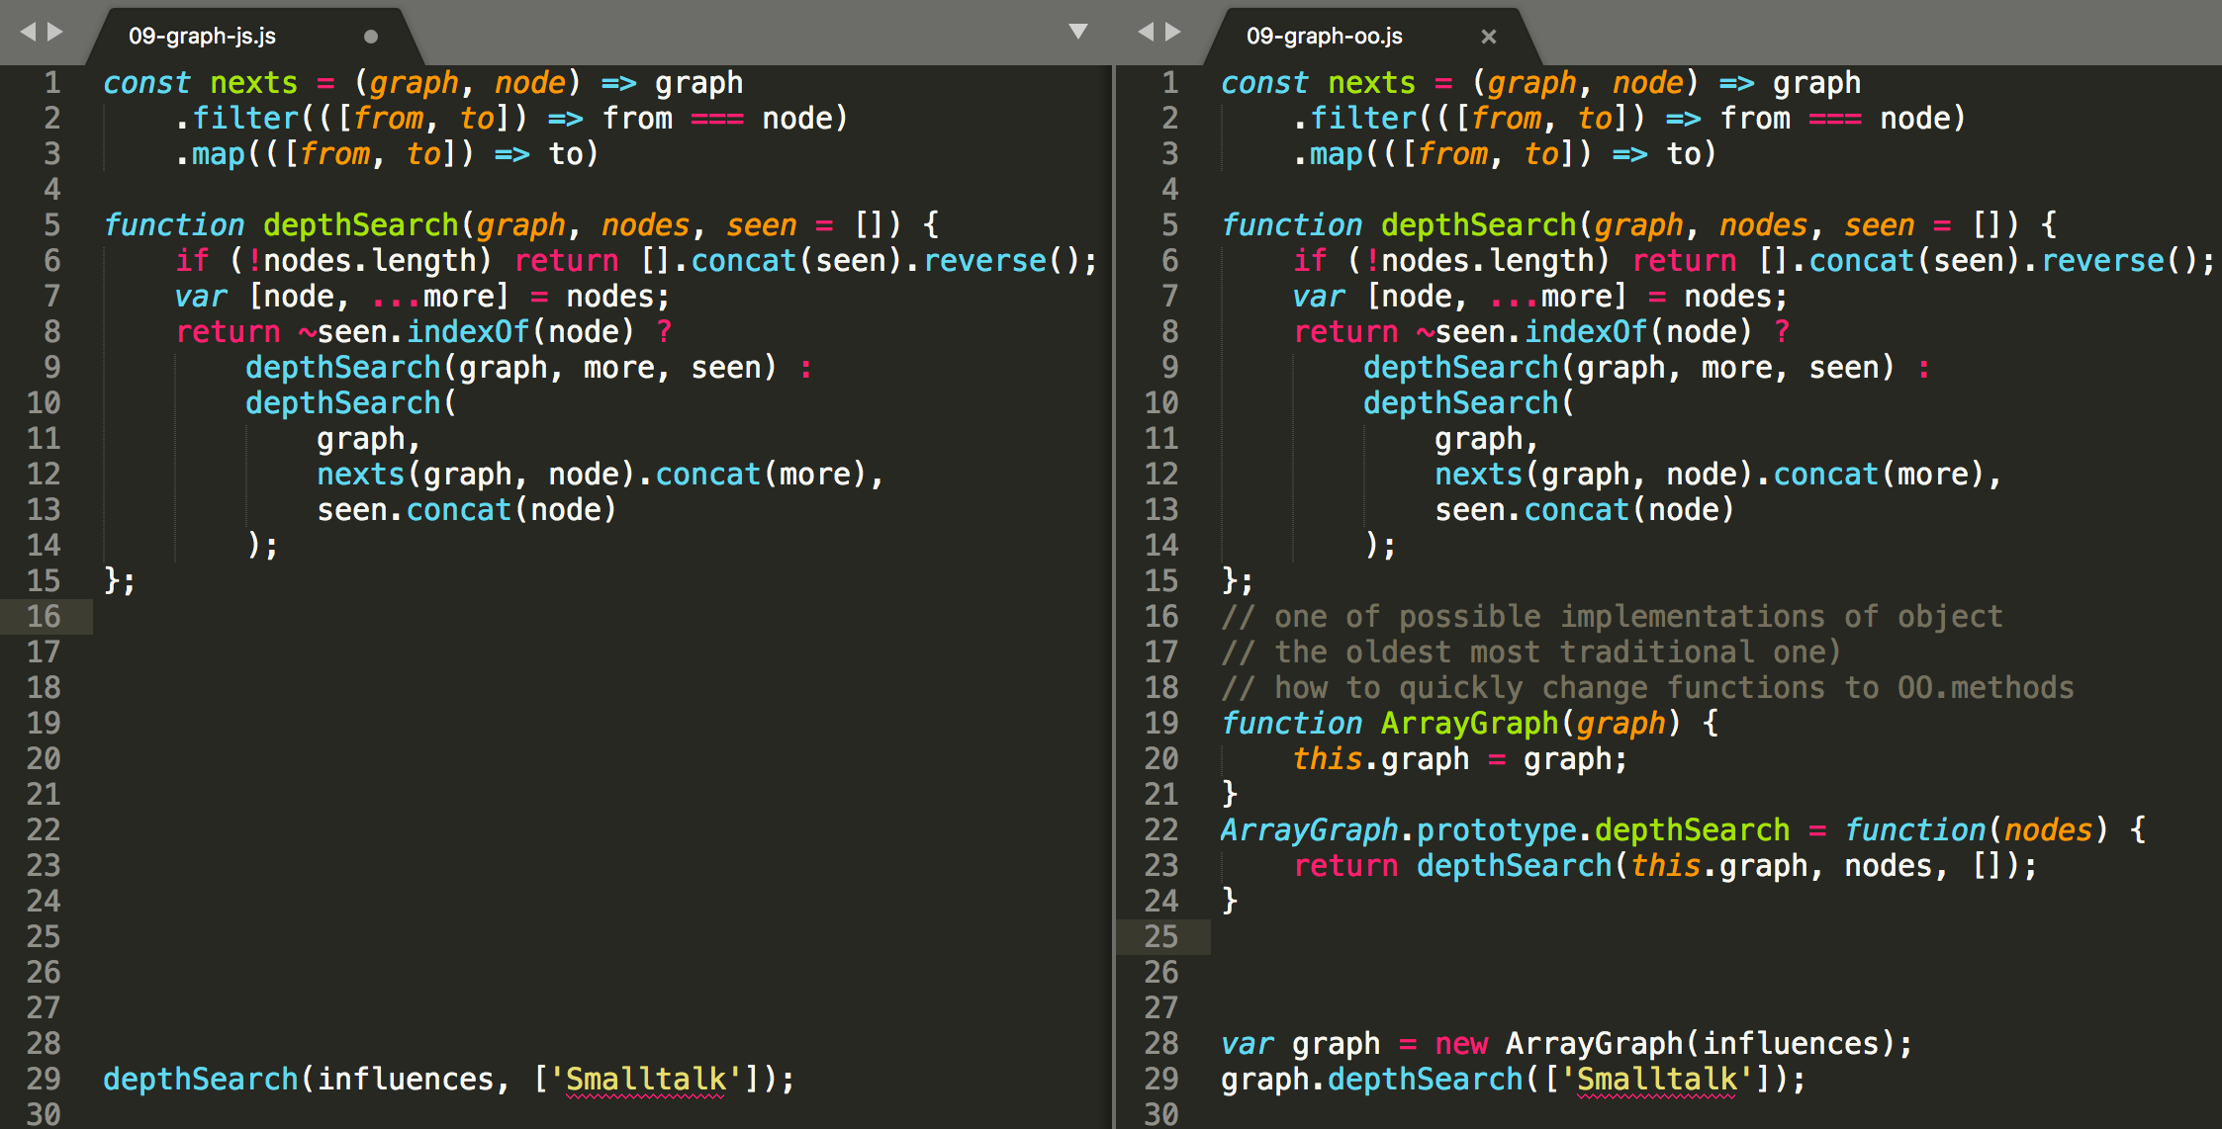
JavaScript - from functions to object+methods

Slide 20
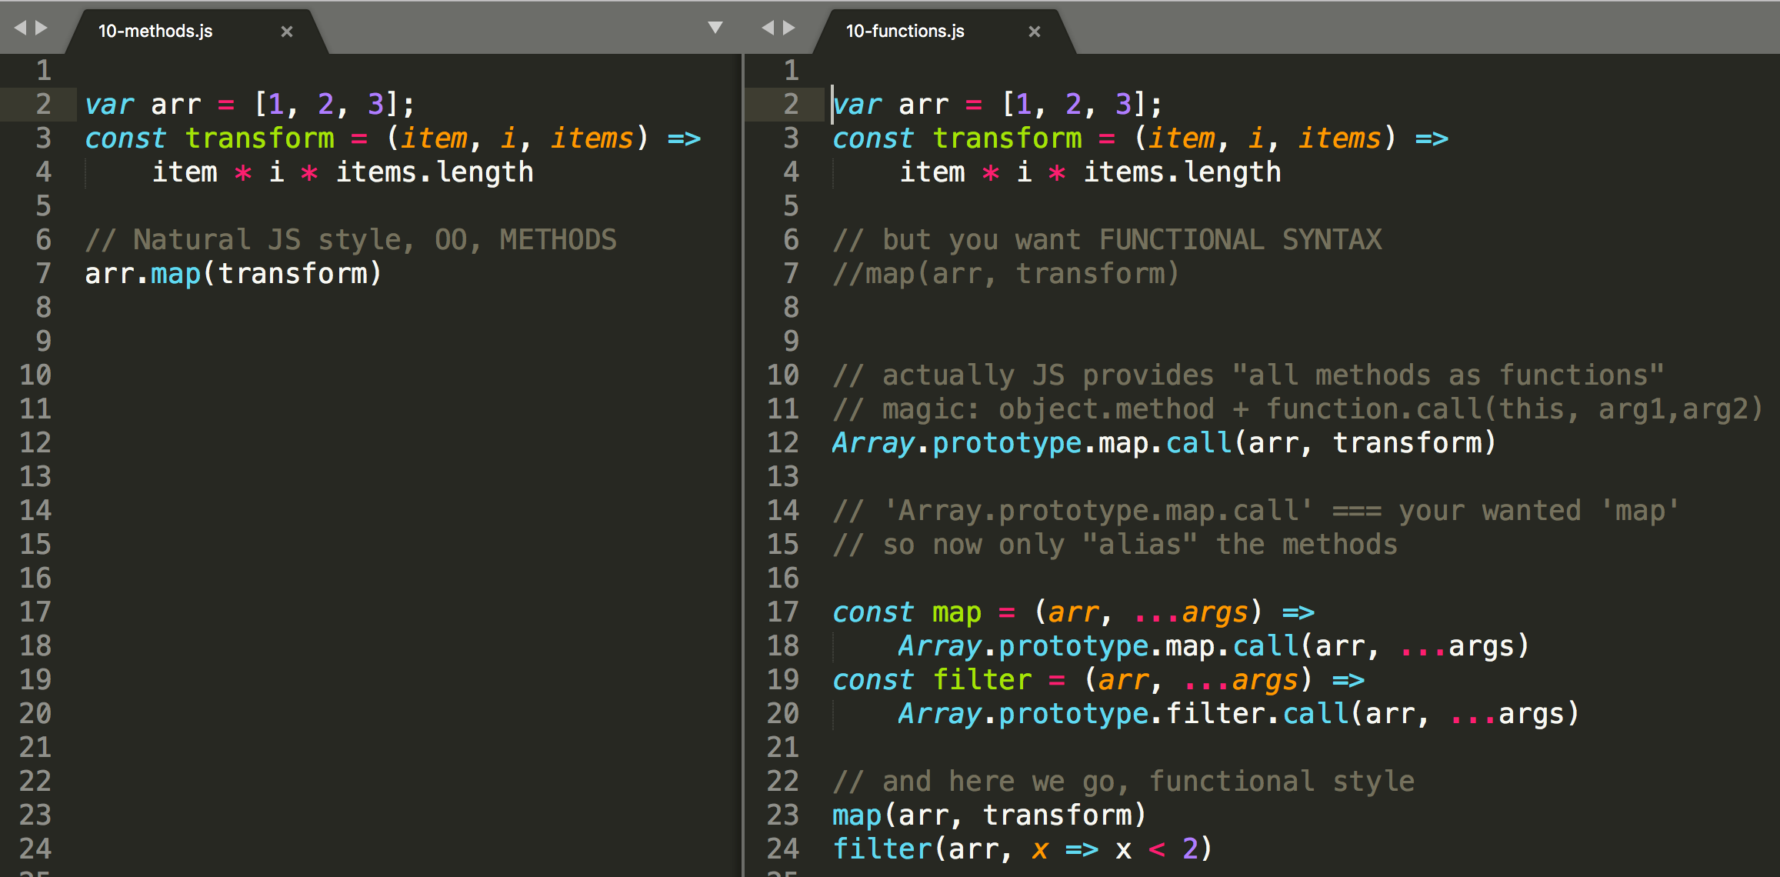
JavaScript - from methods to functions

Slide 21
Pure functions

Slide 22
Pure functions
Referential transparency: The function always gives the same return value for the same arguments. This means that the function cannot depend on any mutable state.
Side-effect free: The function cannot cause any side effects. Side effects may include I/O (e.g., writing to the console or a log file), modifying a mutable object, reassigning a variable, etc.

Slide 23
Pure functions
Benefits of pure functions:
easier to reason about and debug because they don't depend on mutable state
return value can be cached or "memoized" to avoid recomputing it in the future.
easier to test because there are no dependencies

Slide 24
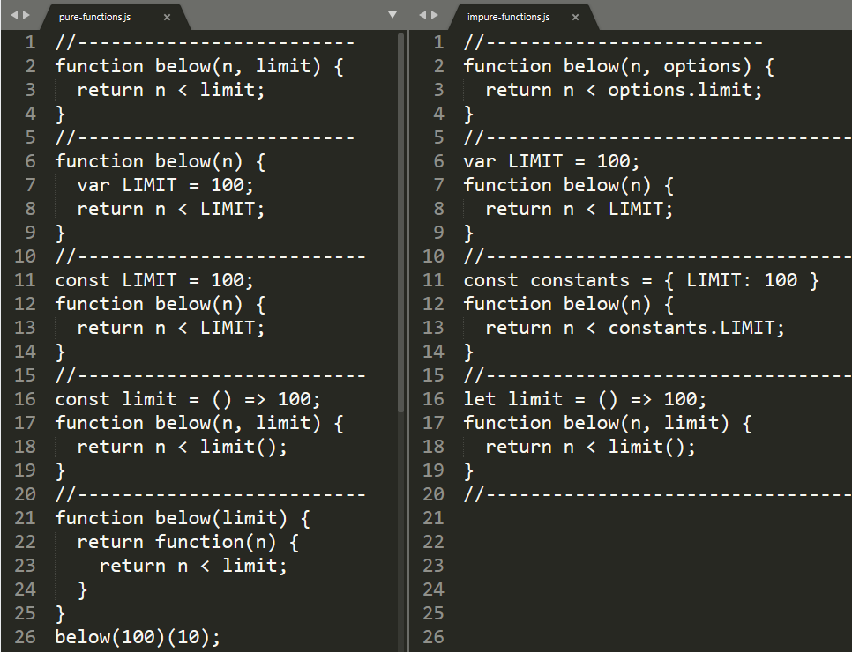
pure functions
function cannot depend on any mutable state
Bad - dependency on:
captured let, var
captured const but with with mutable value
dependency on mutable or impure function
methods are impure by definition
Ok – dependency on:
no captured variables
captured primitive const
captured frozen object const
on constant and pure function
on immutable captured argument

Slide 25
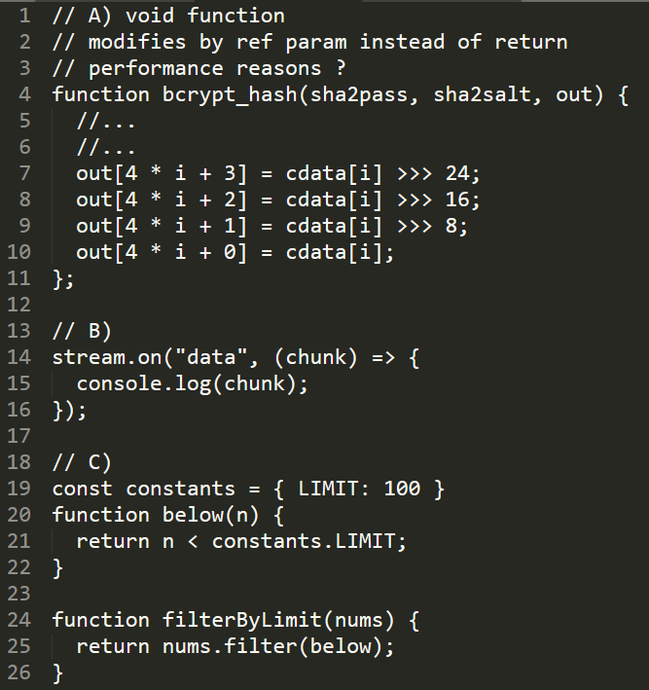
pure functions
Side-effect free
function must return value, if not it is noop or exists to perform side effects
No IO
console.log,…
http, net,…
fs, process,…
DOM, XHR
Use internally pure functions
event listeners are mostly impure, they mutate state or do IO
typical Constructors by definition impure

Slide 26
Pure vs impure functions
Any meaningful program will contain also impure functions (Ajax call, I/O calls, check the current date, or get a random number,...). rule of thumb is to follow the 80/20 rule: 80% of your functions should be pure, and the remaining 20%, of necessity, will be impure.
The general idea is that you write as much of your application as possible in an FP style, and then handle the UI and all forms of input/output (I/O) (such as Database I/O, Web Service I/O, File I/O, etc.) in the best way possible for your current programming language and tools
https://opensource.com/article/17/6/functional-javascript
https://alvinalexander.com/scala/fp-book/pure-functions-and-io-input-output

Slide 27
Higher order functions

Slide 28
Higher order functions
Higher order function is a function that does one of or both:
takes a function as an argument
returns function

Slide 29
Higher order functions – function as argument
Can exist because:
functions are first-class elements
Usage:
callback of async task
toto už sme si ukázali v 03-paradigmy-a-vzory.pptx
parametrized algorithms
napríklad array funkcie z tejto prednášky
ďalšie príklady (builders, …)
transforming function
change signature, bind parameters, change context, add functionality (aspects), curry
parametrized iterations
repeat, until, whilst

Slide 30
parametrized algorithms
TODO: max example:

Slide 31
parametrized iterations

Slide 32
parametrized algorithms - build in JS
domaca uloha: bonuosve zadanie za 5 bodov,
make a complete list of JS API with functions as parameters
TASK: scrape MDN, ES spec, or find other source to automate this

Slide 33
parametrized algorithms
Načo je to dobré ?
Miesto vymýšlania mien funkcii a wrapovania funkcionality,
Vymýšlame názvy replacerov, filtrov, comparatorov a reusujeme ich
replaceSpaces(str)
removeNewLines
removeEmplyLines
sortById
sortCaseInsensitive
findOldest(arr)
serializeNonPrivate(obj)
str.replace(spaces,"-")
str.replace(newlines,"")
str.replace(newlines,removeEmpty)
arr.sort(byId)
arr.sort(caseInsensitive)
arr.find(oldest)
json.stringify(o, nonPrivate)

Slide 34
Higher order functions – functions returning functions
transform one function somehow
change signature,
bind parameters,
change context,
add functionality (aspects)
curry
combine functions
…

Slide 35
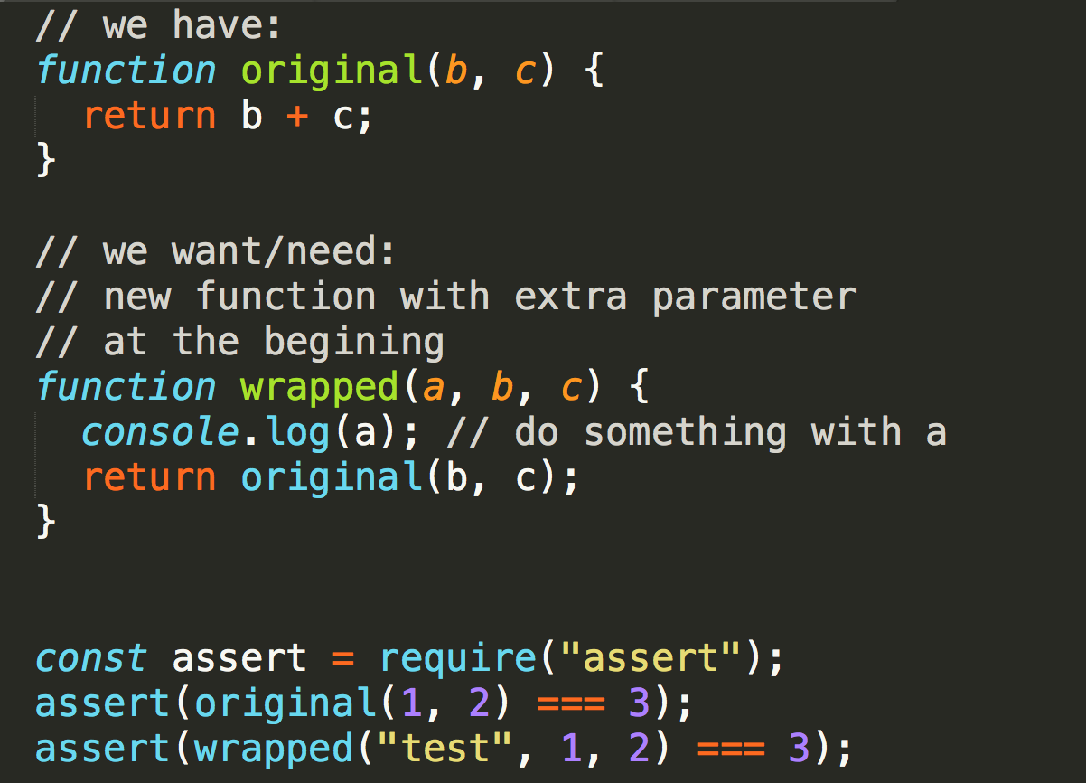
transforming functions - example
Principle:
create new function, call the original
super easy with arrows
good for single/simple ad-hoc needs
does not scale (see another slide)

Slide 36
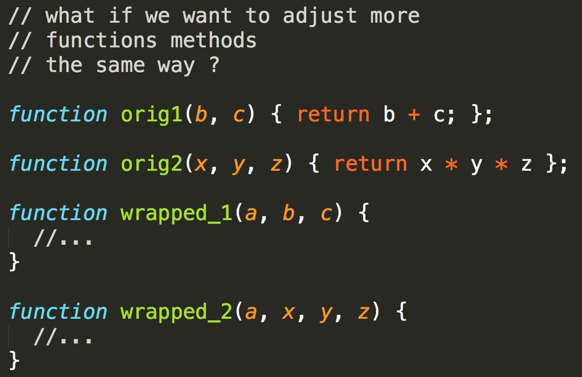
transforming functions - example
does not scale
must reimplement each method

Slide 37
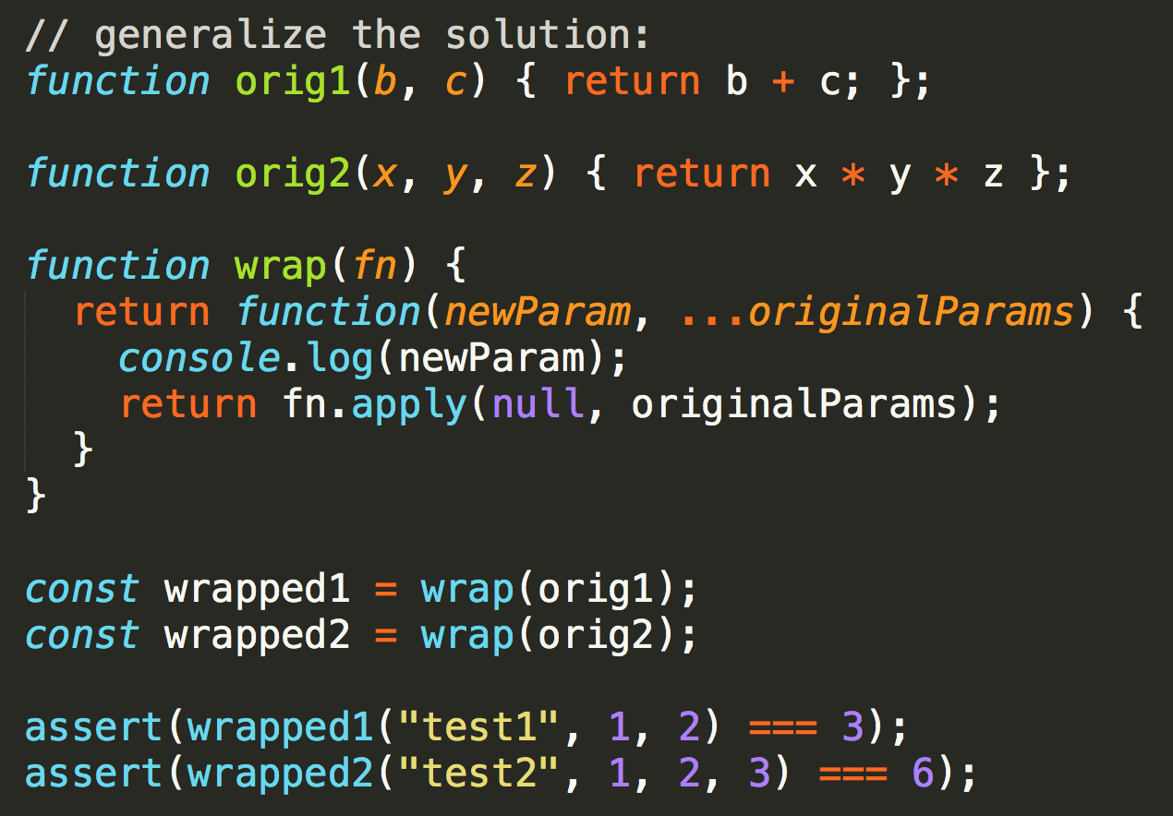
transforming functions - example
Solution:
create transform function
taking original as parameter
and returning modified function
create new functions by calling transform with original
call transformed

Slide 38
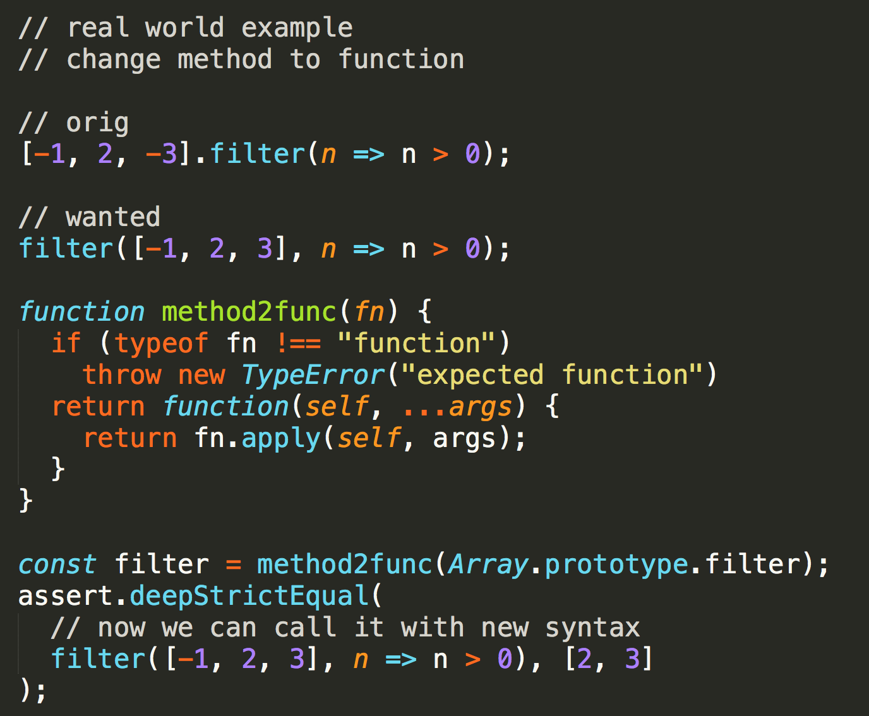
transforming functions - example
Example described so far is about adding extra parameter to the beginning of method signature, what is the usage ? one of them can be:
extract this as method parameter
in other words, change methods to functions

Slide 39
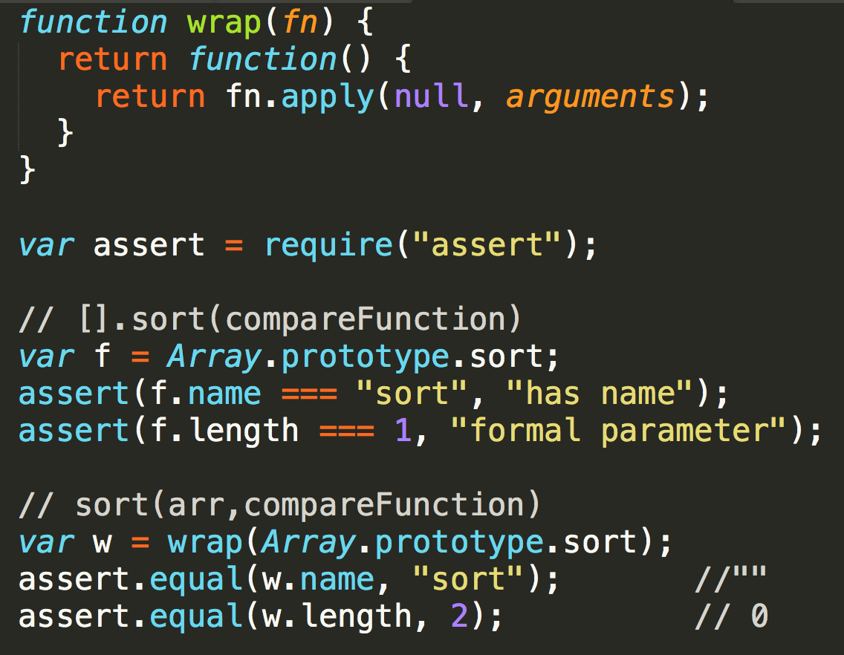
transforming functions – function members
Problem with returned functions is that
they are often unnamed
or have static name
and have incorrect fn.length
Function name
A Function object's read-only name property indicates the function's name as specified when it was created, or "anonymous" for functions created anonymously.
Function.length
length is a property of a function object, and indicates how many arguments the function expects, i.e. the number of formal parameters.
This number excludes the rest parameter and only includes parameters before the first one with a default value. By contrast, arguments.length is local to a function and provides the number of arguments actually passed to the function.
this fails

Slide 40
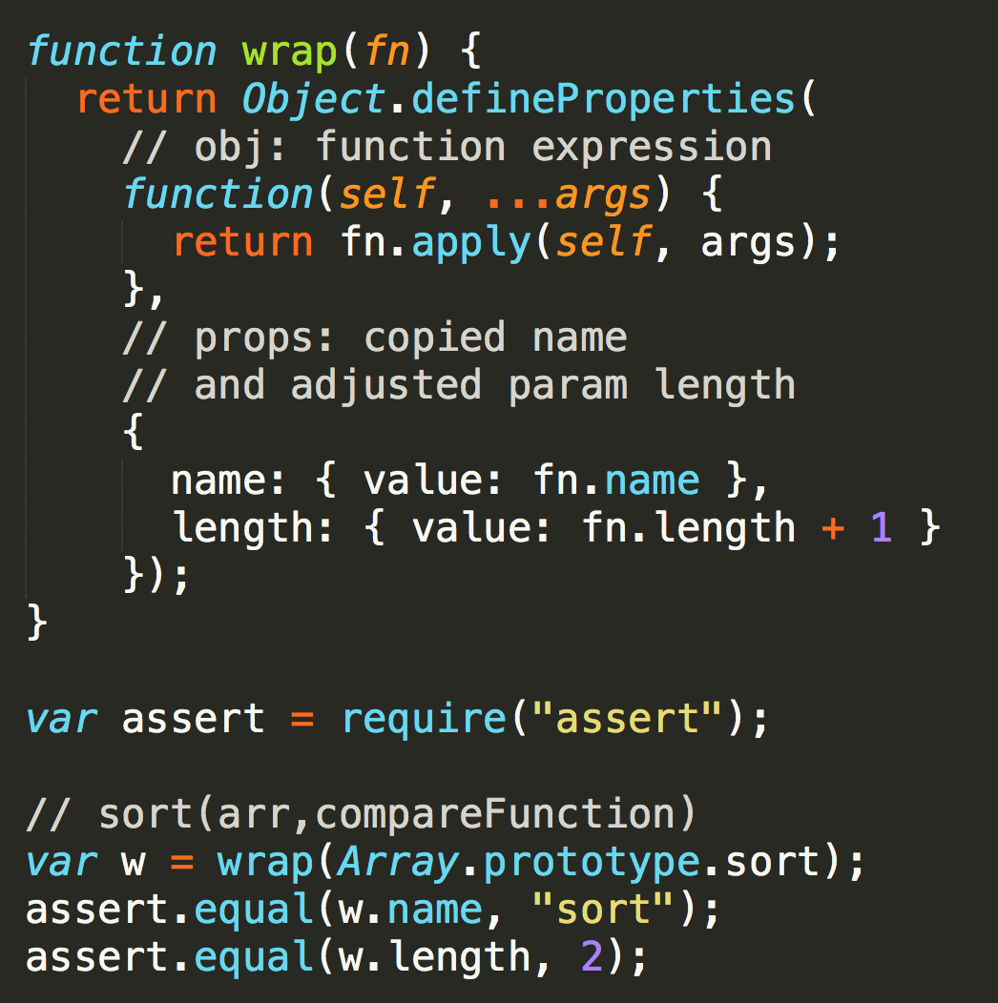
transforming functions – patterns
Pattern: return function with calculated name and length
Purpose: Good to preserve original function names and reflect possibly changed formal parameters count, good for destructoring and shothand assignments, debugging, introspection, tools, docs,...
Mechanism: functions get their names based how they are defined (see MDN). There is no syntactic way to define function with dynamic name (only method with dynamic name), trick lies in defineProperty(o,desc) returning o, which is pretty short syntax
Example: method2function from previous slides
TODO: lambda for noop wrapper

Slide 41
tranformations
Ad-hoc – good with arrow for one shot or super simple tasks
Generic – good for transforming multiple functions
returning function
call, apply
bind

Slide 42
Immutability

Slide 43
Immutability
Immutability is essential in FP and VOP
Immutability can be forced by language or we have to rely on coding discipline
In JS:
By default things are mutable in JS
A lot of build-in apis are designed as mutable
with FP trends JavaScript is taking evolution towards immutability as well

Slide 44
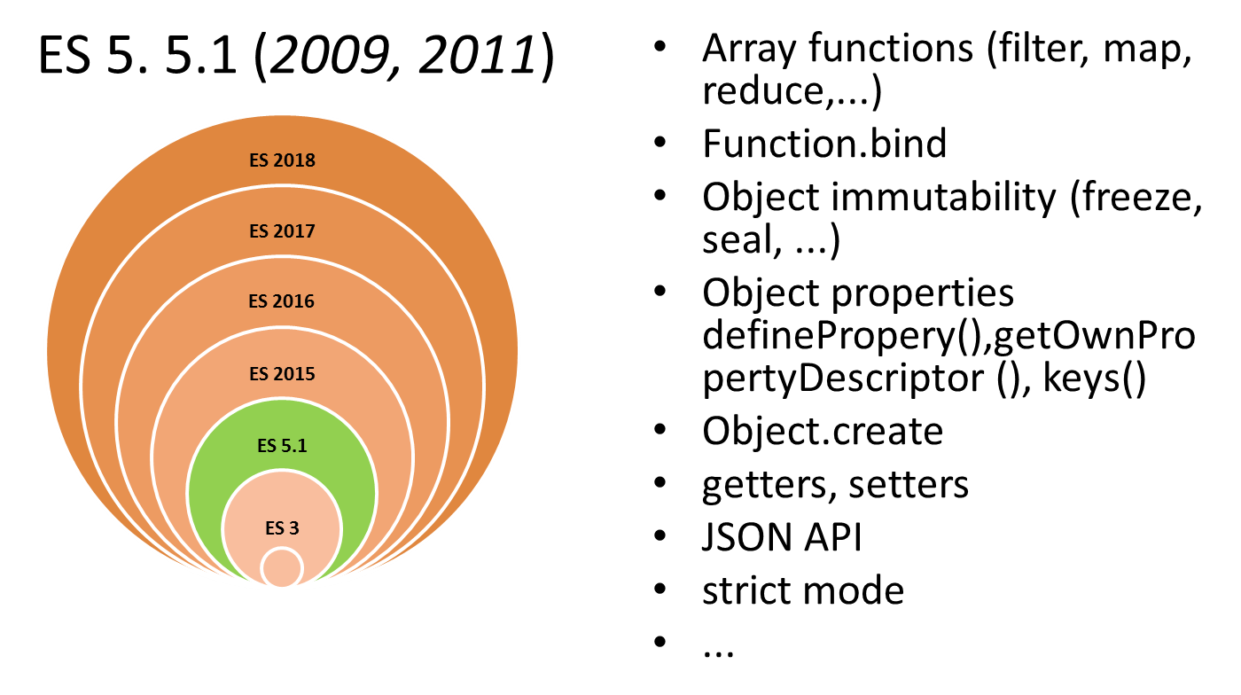
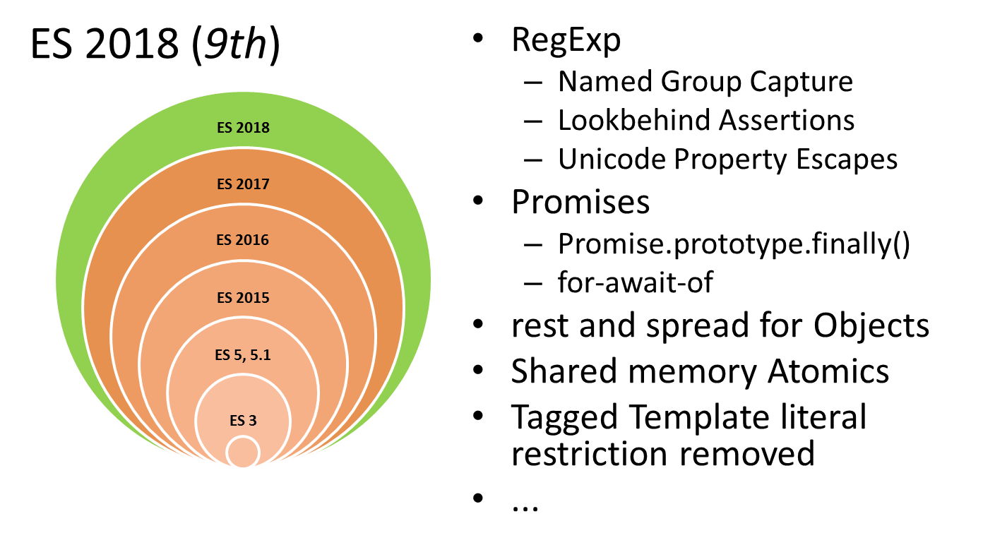
Immutability support in JavaScript
primitive types are immutable
object is mutable (by default),
all other data structures are objects so they are mutable as well
ES 5.1
nonwritable properties (Object.defineProperty, Object.create)
Object.freeze, …
strict mode
ES 2015
const
destructuring, spread
ES 2018
rest and spread for Objects as well

Slide 45
Immutability – shared state
orthodox function programming – no shared state
real JS programs - we often see and use state
captured variables in closures, module variables,shared reused modules, objects,....
Shared state is fine if it is immutable
Mutable state is fine if it is not shared.

Slide 46
Shared state is fine if it is immutable, Mutable state is fine if it is not shared.
Čo máme považovať za state, kedy je a nie je shared, Čo to znamená mutable
State:
variable with value, function call argument
Shared:
strictly : visible by more than one function
visible outside of module
ES6 module live binding
visible by scope or passed as argument
inherited by prototype chain
returned by function
Mutable variable:
non const variable can be reasigned value (let, var)
default object member (writable)
FunctionDeclaration
non const FunctionExpression or ArrowFunctionExpression
Mutable value:
non primitive data types – Object (Array, ….) with mutable members (props, values) or mutator methods
State:
variable with value, function call argument
Not Shared:
strictly: no shared variables – parametrized/bound functions
private to module, not exported
CJS copied
…
own private property
….
Immutable variable:
const
nonwritable object member
…
const FunctionExpression or ArrowFunctionExpression
Immutable value:
primitive data types, frozen objects, special userland structures

Slide 47
How to achieve immutability and produce changed values
Immutable variable:
const
nonwritable object member
…
const FunctionExpression or ArrowFunctionExpression
Immutable value:
primitive data types,
frozen objects
special userland structures
Returning clones:
copy object to change property value
clone array to add, remove or modify items
…
…

Slide 48
TODO: do not modify, return new value
shallow copy (object, array)
using API
using new syntax
deep copy (object, array)
userland libraries

Slide 49
TODO: recursion
name in func-dec vs. func-expr
stack limits and optimization

Slide 50
TODO: curry

Slide 51
TODO: traversing objects
RECAP: objects as value
custom traverse (recursive)
userland libraries samples

Slide 52

_aux

Slide 53
Some deep thoughts
JavaScript doesn’t have immutability built in, spread operator and external libs can easily help in implementing it though. If immutability is about rules, then everything is in the developer hands. If you see the value of value then from this moment the mutation should be gone in your application.
However the problem is in bad habits, bad habits mostly from object oriented programming. Bad practices are in our minds, under our skin. Bad practices like setters in the object, methods mutating the object state, object as state, huge polymorphic objects and so on, these things should be considered as wrong and never used again.
Change your way of thinking, see the value of value. Choosing immutability is a big step towards predictable, more efficient and less buggy programs.
https://medium.com/dailyjs/the-state-of-immutability-169d2cd11310

Slide 54
Why mutable is bad
The worst scenario takes place when some structure is used in separate parts of the application, then any mutation in one component can create a bug in the other one. Such bug is really hard to track because the source of the problem lies out of the scope of the failure. This is an example of a bad side effect.
TODO: Napisat nieco o moduloch ze su singeltony a ze su kesovane a ked ho pouziju dvaja a niekto ho prekonfiguruje aj tvj zacne blbnut, to je asi nahorsia ukazka celej ten veci co poznam

Slide 55
Freeze seal
https://stackoverflow.com/questions/21402108/difference-between-freeze-and-seal-in-javascript
spravte si vlastny exploratory test

Slide 56
Summary

Slide 57
Functional JavaScript (Summary)
JavaScript is a multi-paradigm language
It can be used to program functionally (specially with “modern JS”)
But (my opinion, my current “functional JS POV”), so far on covered topics
use functional concepts for business, keep the rest “as needed” (procedural, declarative)
use functional concepts for functional problems
use chaining (nicer syntax, more readable programs)
use (parameter) destructuring, rest parameters, defaults (less bloated code, less need for low level FP primitives, branching)
use (study) JS syntax, if exists whenever possible, do not hide known JS under unknown libs
do not implement low level functional features by reusing functional features (e.g use raw loops to implement _ranges, etc…, beware performance, O(n), call stack price, memory)
do not implement functional low level features, use libs (eg. _underescore.js), use only what needed, more and more is replaced by standard JS syntax)
use arrow functions only for inlines (I like hoisting, more readable programs, top down reading, code first, then functions, function(){}, vs const=()=>{})
do not follow blindly FP concepts eg. “using functions instead of values” f(f()) vs f(v), we can have f(funOrValue)
use recursion only where appropriate for “problem solving”, reduce is almost always fine if not needing quick exits
implement mappers, filters, reducers, instead of implementing “whole methods”

